Slide 1
5th Grade Monday (2 Slides)
Math: 5.OA.A.2Write simple expressions that record calculations with numbers and interpret numerical expressions without evaluating them.
Complete 2 I-ready lessons each week.
ELA: Using details to support inferences. (RI.KID.1) Using context clues to determine the meanings of unknown words. (FL.5.1)
Iready teacher assigned lesson for RI.KID.1
Use IXL to practice using context clues
*Refer to SS for writing prompt.
Week 1
Physical Science - Welcome, Scientists
Log in through Clever:
Studies weekly/ Science 5th grade
S. Studies: Log in through Clever
Studies Weekly/Social Studies 5th grade
TN5-1 (An Industrial Move)
Grade 5 Volume 1 Issue 1
Directions: Read through the article and answer questions under Think and Review (1-4)
Weekly Writing Prompt: Write one paragraph explaining the reasons the South had to embrace industrialization after the Civil War. Be sure to check for correct grammar, spelling and punctuation.
Science:

Slide 2
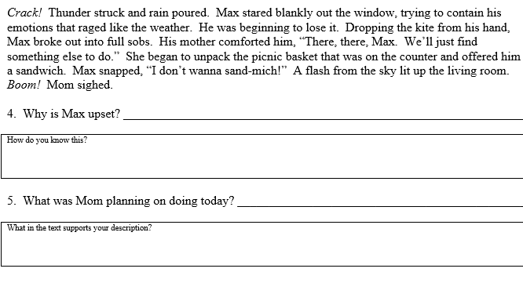
5th Grade Monday (“Do Nows” and important info.)
Math:
Write an expression for the operation described below.
multiply 10 by 4
ELA: Directions: Read each passage and then respond to the questions.
Mrs. Bryant’s office hours: Tuesday 11-1/Thurs. 12:20-2:30 via Class Dojo or 901-306-6813
Mr. Pumphrey’s office hours: Tuesday 11-1/Thurs: 12:30-2:30 901-290-3796
Ms. Davis’s office hours: Tues: 11-1/Thurs: 3-5 (901)602-6014
Ms. Payne’s office hours: Tues: 11-1/Thurs: 3-5
(662) 913-9133, paynec@scsk12.org, ClassDojo
Social Emotional Learning
Week of April 6, 2020
Name Your Emotion
Guardians have your child to state how they are feeling each day. This can be done with just you and the child, or as a group with the entire household. This helps everyone to know how everyone is feeling, what different emotions look like and how to better interact with family members based on how they are feeling.

Slide 3
5th Grade Tuesday (2 Slides)
Math: 5.OA.A.2Write simple expressions that record calculations with numbers and interpret numerical expressions without evaluating them.
Complete 2 I-ready lessons each week.
ELA: Using details to support inferences. (RI.KID.1) Using context clues to determine the meanings of unknown words. (FL.5.1)
Iready teacher assigned lesson for RI.KID.1
Use IXL to practice using context clues
*Refer to SS for writing prompt.
Week 1
Physical Science - Welcome, Scientists
Log in through Clever:
Studies weekly/ Science 5th grade
S. Studies: Log in through Clever
Studies Weekly/Social Studies 5th grade
TN5-1 (An Industrial Move)
Grade 5 Volume 1 Issue 1
Directions: Read through the article and answer questions under Think and Review (1-4)
Weekly Writing Prompt: Write one paragraph explaining the reasons the South had to embrace industrialization after the Civil War. Be sure to check for correct grammar, spelling and punctuation.
Science:

Slide 4
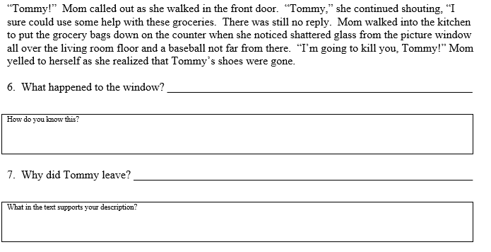
5th Grade Tuesday (“Do Nows” and important info.)
Math:
Write an expression for the sequence of operations described below.
Add 8 and 10, then multiply 3 by the result
ELA: Directions: Read each passage and then respond to the questions.
Mrs. Bryant’s office hours: Tuesday 11-1/Thurs. 12:20-2:30 via Class Dojo or 901-306-6813
Mr. Pumphrey’s office hours: Tuesday 11-1/Thurs: 12:30-2:30 901-290-3796
Ms. Davis’s office hours: Tues: 11-1/Thurs: 3-5 (901)602-6014
Ms. Payne’s office hours: Tues: 11-1/Thurs: 3-5
(662) 913-9133, paynec@scsk12.org, ClassDojo

Slide 5
5th Grade Wednesday (2 Slides)
Math: 5.OA.A.2Write simple expressions that record calculations with numbers and interpret numerical expressions without evaluating them.
Complete 2 I-ready lessons each week.
ELA: Using details to support inferences. (RI.KID.1) Using Greek and Latin root words to determine the meanings of unknown words. (FL.5.1)
Iready teacher assigned lesson for RI.KID.1
Use IXL to practice using Greek and Latin root words.
*Refer to SS for writing prompt.
S. Studies: Log in through Clever
Studies Weekly/Social Studies 5th grade
TN5-1 (An Industrial Move)
Grade 5 Volume 1 Issue 1
Directions: Read through the article and answer questions under Think and Review (1-4)
Weekly Writing Prompt: Write one paragraph explaining the reasons the South had to embrace industrialization after the Civil War. Be sure to check for correct grammar, spelling and punctuation.
Science:

Slide 6
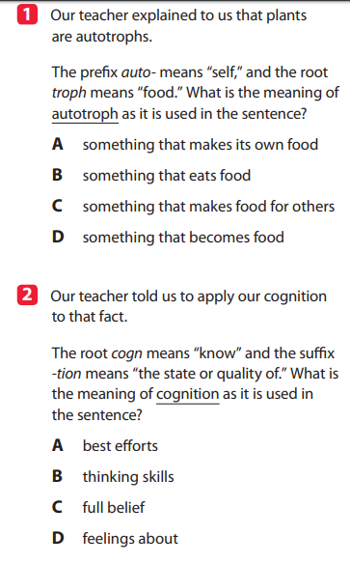
5th Grade Wednesday (“Do Nows” and important info.)
Math:
Write an expression for the sequence of operations described below.
Add 10 to 3, then divide 9 by the result
ELA:
Mrs. Bryant’s office hours: Tuesday 11-1/Thurs. 12:20-2:30 via Class Dojo or 901-306-6813
Mr. Pumphrey’s office hours: Tuesday 11-1/Thurs: 12:30-2:30 901-290-3796
Ms. Davis’s office hours: Tues: 11-1/Thurs: 3-5 (901)602-6014
Ms. Payne’s office hours: Tues: 11-1/Thurs: 3-5
(662) 913-9133, paynec@scsk12.org, ClassDojo

Slide 7
5th Grade Thursday (2 slides)
Math: 5.OA.A.2Write simple expressions that record calculations with numbers and interpret numerical expressions without evaluating them.
Complete 2 I-ready lessons each week.
ELA: Using details to support inferences. (RI.KID.1) Using Greek and Latin root words to determine the meanings of unknown words. (FL.5.1)
Iready teacher assigned lesson for RI.KID.1
Use IXL to practice using Greek and Latin root words.
*Refer to SS for writing prompt.
Week 1
Physical Science - Welcome, Scientists
Log in through Clever:
Studies weekly/ Science 5th grade
S. Studies: Log in through Clever
Studies Weekly/Social Studies 5th grade
TN5-1 (An Industrial Move)
Grade 5 Volume 1 Issue 1
Directions: Read through the article and answer questions under Think and Review (1-4)
Weekly Writing Prompt: Write one paragraph explaining the reasons the South had to embrace industrialization after the Civil War. Be sure to check for correct grammar, spelling and punctuation.
Science:

Slide 8
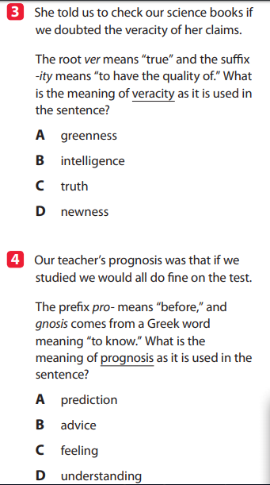
5th Grade Thursday (“Do Nows” and important info.)
Math: Write an expression for the sequence of operations described below.
subtract 3 from 9, then subtract 2 from the result
ELA:
Mrs. Bryant’s office hours: Tuesday 11-1/Thurs. 12:20-2:30 via Class Dojo or 901-306-6813
Mr. Pumphrey’s office hours: Tuesday 11-1/Thurs: 12:30-2:30 901-290-3796
Ms. Davis’s office hours: Tues: 11-1/Thurs: 3-5 (901)602-6014
Ms. Payne’s office hours: Tues: 11-1/Thurs: 3-5
(662) 913-9133, paynec@scsk12.org, ClassDojo

Slide 9
5th Grade Friday (2 Slides)
Math: 5.OA.A.2Write simple expressions that record calculations with numbers and interpret numerical expressions without evaluating them.
Complete 2 I-ready lessons each week.
ELA: Using details to support inferences. (RI.KID.1) Using context clues to determine the meanings of unknown words. (FL.5.1)
Iready teacher assigned lesson for RI.KID.1
Iready teacher assigned lesson for close read.
*Refer to SS for writing prompt.
Week 1
Physical Science - Welcome, Scientists
Log in through Clever:
Studies weekly/ Science 5th grade
S. Studies: Log in through Clever
Studies Weekly/Social Studies 5th grade
TN5-1 (An Industrial Move)
Grade 5 Volume 1 Issue 1
Directions: Read through the article and answer questions under Think and Review (1-4)
Weekly Writing Prompt: Write one paragraph explaining the reasons the South had to embrace industrialization after the Civil War. Be sure to check for correct grammar, spelling and punctuation.
Science:

Slide 10
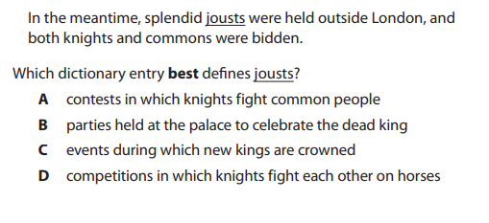
5th Grade Friday (“Do Nows” and important info.)
Math:
Write an expression for the sequence of operations described below.
multiply 8 by 5, then multiply 9 by the result
Mrs. Bryant’s office hours: Tuesday 11-1/Thurs. 12:20-2:30 via Class Dojo or 901-306-6813
Mr. Pumphrey’s office hours: Tuesday 11-1/Thurs: 12:30-2:30 901-290-3796
Ms. Davis’s office hours: Tues: 11-1/Thurs: 3-5 (901)602-6014
Ms. Payne’s office hours: Tues: 11-1/Thurs: 3-5
(662) 913-9133, paynec@scsk12.org, ClassDojo
ELA:

